Slide 1
Design analysis and algorithm
Presenter:Srestha Sadhu

Slide 2
SELECTION SORT

Slide 3
Selection Sort
The selection sort algorithm sorts an array by repeatedly finding the minimum element (considering ascending order) from unsorted part and putting it at the beginning. The algorithm maintains two sub arrays in a given array.
1)The sub array which is already sorted.
2) Remaining sub array which is unsorted.
In every iteration of selection sort, the minimum element (considering ascending order) from the unsorted sub array is picked and moved to the sorted sub array.

Slide 4
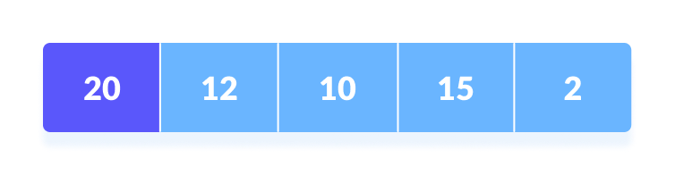
How Selection Sort Works?
1. Set the first element as minimum.
2. Compare minimum with the second element. If the second element is smaller than minimum, assign the second element as minimum.
Compare minimum with the third element. Again, if the third element is smaller, then assign minimum to the third element otherwise do nothing. The process goes on until the last element.

Slide 5
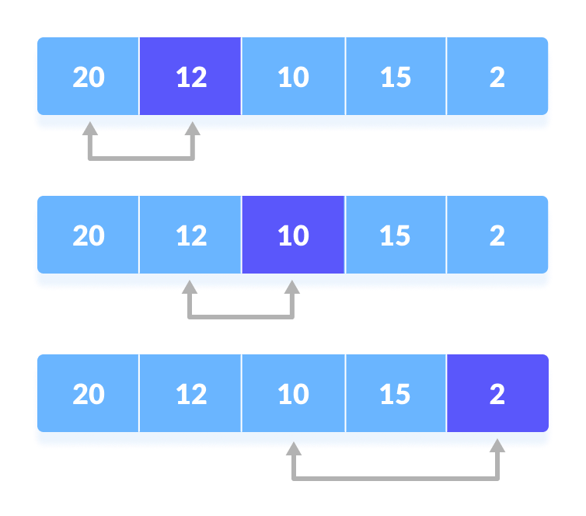
Compare minimum with the remaining one

Slide 6
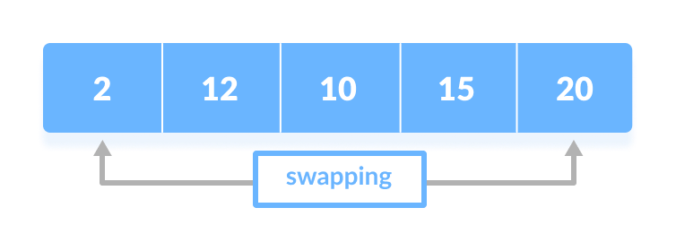
3.After each iteration, minimum is placed in the front of the unsorted list.
.
Swap the first with minimum

Slide 7
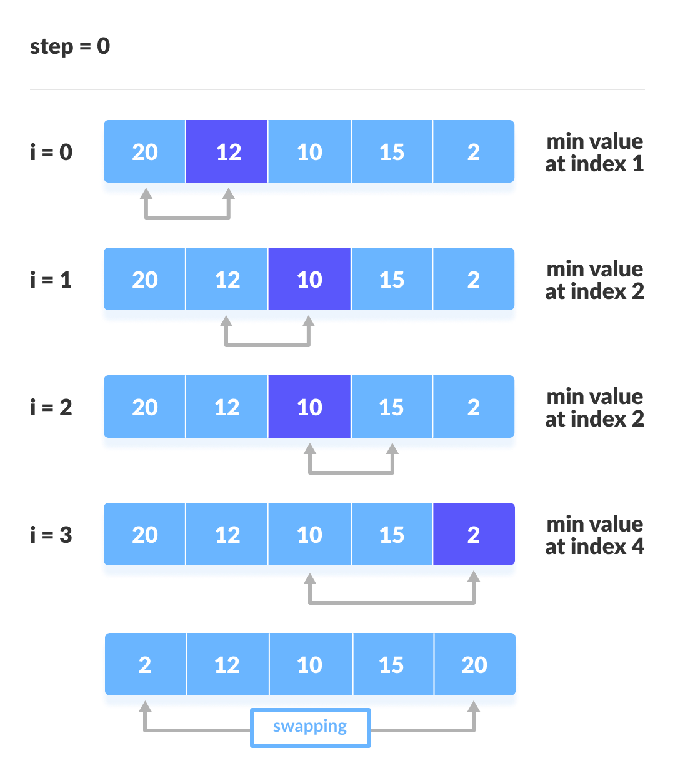
4.For each iteration, indexing starts from the first unsorted element. Step 1 to 3 are repeated until all the elements are placed at their correct positions
The first iteration

Slide 8
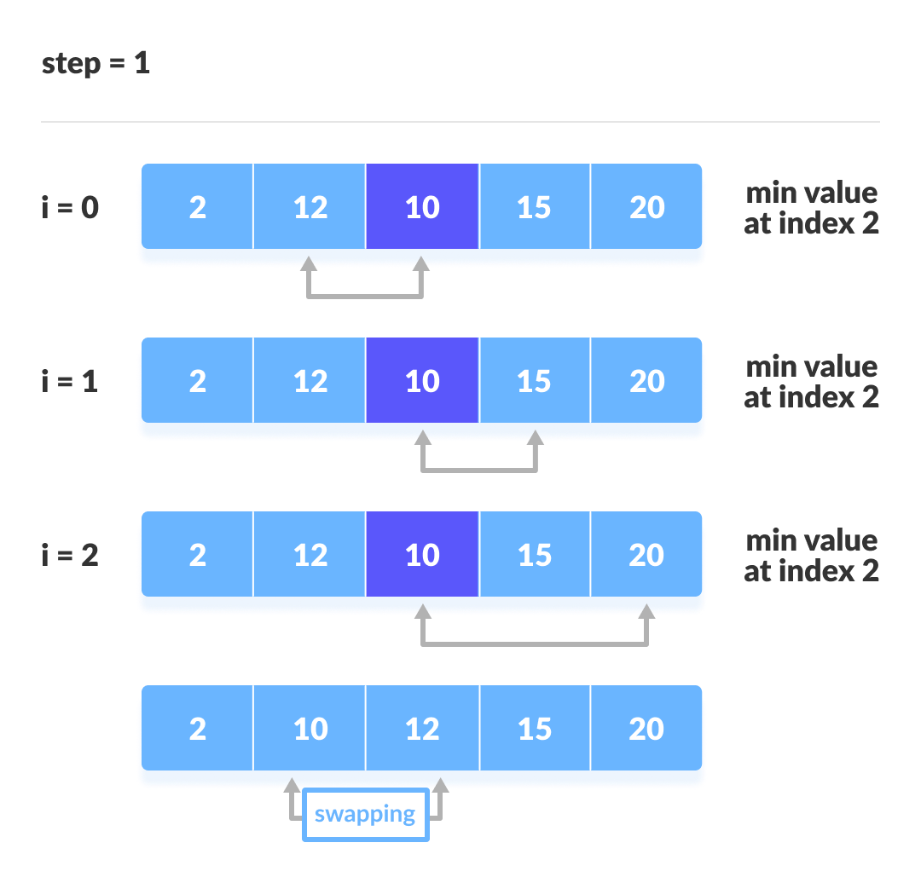
The Second iteration

Slide 9
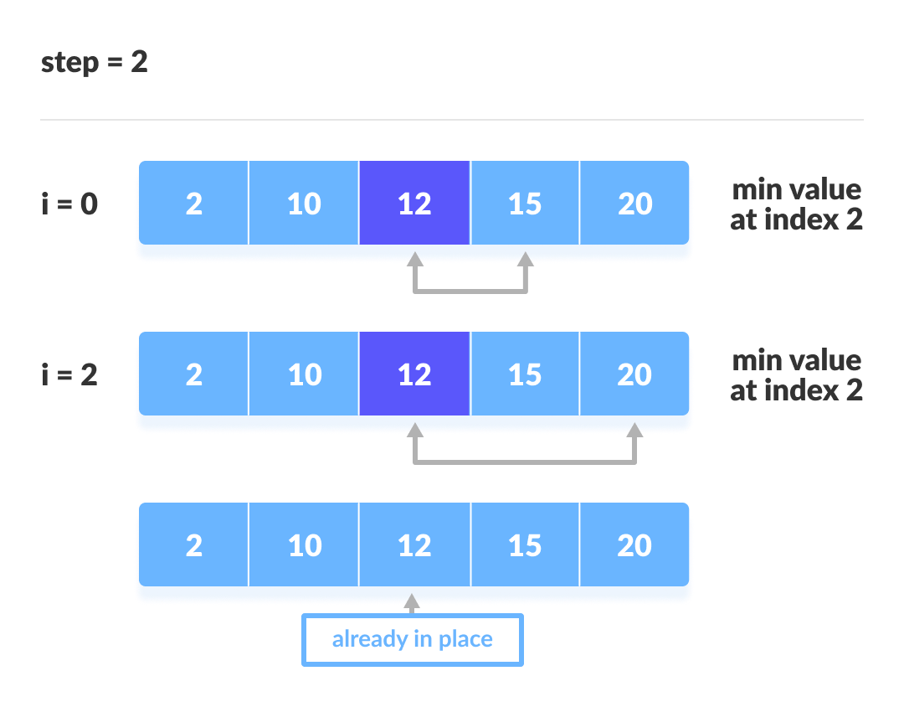
The Third iteration

Slide 10
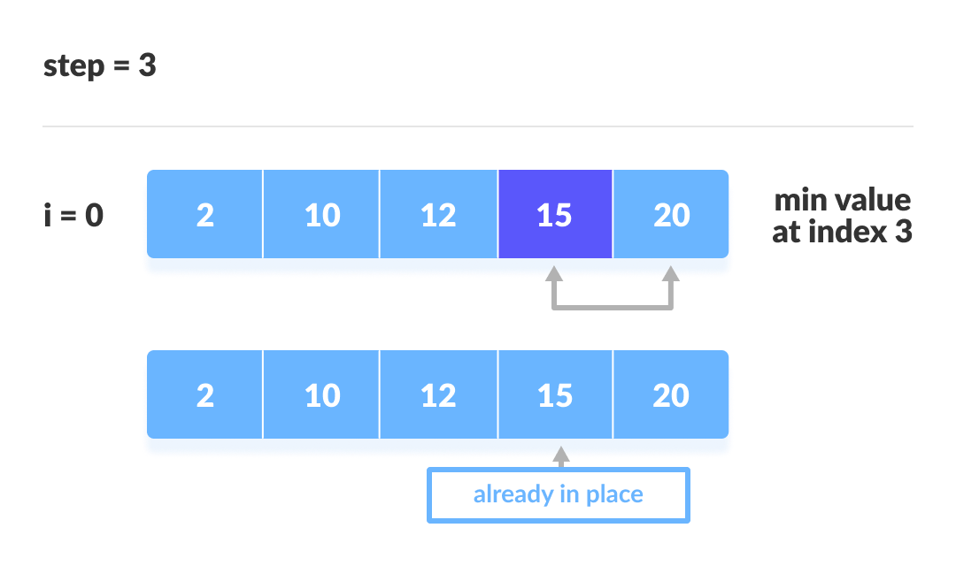
The fourth iteration

Slide 11
Selection Sort Algorithm
Step 1 − Set min to the first location
Step 2 − Search the minimum element in the array
Step 3 – swap the first location with the minimum value in the array
Step 4 – assign the second element as min.
Step 5 − Repeat the process until we get a sorted array.

Slide 12
Finding Smallest Element in a sub array
In selection sort, in the first step, we look for the smallest element in the array and replace it with the element at the first position.
Consider that you have an array with following values {3, 6, 1, 8, 4, 5}.
Now as per selection sort, we will start from the first element and look for the smallest number in the array, which is 1 and we will find it at the index 2.
Once the smallest number is found, it is swapped with the element at the first position.
In the next iteration, we will have to look for the second smallest number in the array.
we already have the smallest number/element at the first position, which is the right position for it and we do not have to move it anywhere now.
So we can say, that the first element is sorted, but the elements to the right, starting from index 1 are not.

Slide 13
So, we will now look for the smallest element in the sub array, starting from index 1, to the last index.
After we have found the second smallest element and replaced it with element on index 1(which is the second position in the array), we will have the first two positions of the array sorted.
Then we will work on the sub array, starting from index 2 now, and again looking for the smallest element in this sub array.

Slide 14
Complexity Analysis of Selection Sort
Selection Sort requires two nested for loops to complete itself
Hence for a given input size of n, following will be the time and space complexity for selection sort algorithm:
Worst Case Time Complexity [ Big-O ]: O(n²)
Best Case Time Complexity [Big-omega]: O(n²)
Average Time Complexity [Big-theta]: O(n²)
Space Complexity: O(1)

Slide 15
INSERTION SORT

Slide 16
INSERTION Sort
Insertion sort is a simple sorting algorithm that works similar to the way you sort playing cards in your hands.
The array is virtually split into a sorted and an unsorted part.
Values from the unsorted part are picked and placed at the correct position in the sorted part.

Slide 17


Slide 18
Another Example of Insertion Sort:
12, 11, 13, 5, 6
Let us loop for i = 1 (second element of the array) to 4 (last element of the array)
i = 1. Since 11 is smaller than 12, move 12 and insert 11 before 12
11, 12, 13, 5, 6
i = 2. 13 will remain at its position as all elements in A[0..I-1] are smaller than 13
11, 12, 13, 5, 6
i = 3. 5 will move to the beginning and all other elements from 11 to 13 will move one position ahead of their current position.
5, 11, 12, 13, 6
i = 4. 6 will move to position after 5, and elements from 11 to 13 will move one position ahead of their current position.
5, 6, 11, 12, 13

Slide 19
Insertion sort ALGORITHM
To sort an array of size n in ascending order:
1: Iterate from arr[1] to arr[n] over the array.
2: Compare the current element (key) to its predecessor.
3: If the key element is smaller than its predecessor, compare it to the elements before. Move the greater elements one position up to make space for the swapped element.

Slide 20
EXAMPLE
int array[5] = {5, 1, 6, 2, 4, 3};
We took an array with 6 integers. We took a variable key, in which we put each element of the array, during each pass, starting from the second element, that is a[1].
Then using the while loop, we iterate, until j becomes equal to zero or we find an element which is greater than key, and then we insert the key at that position.
We keep on doing this, until j becomes equal to zero, or we encounter an element which is smaller than the key, and then we stop.
The current key is now at the right position.
We then make the next element as key and then repeat the same process.

Slide 21
In the above array, first we pick 1 as key, we compare it with 5(element before 1),
1 is smaller than 5, we insert 1 before 5.
Then we pick 6 as key, and compare it with 5 and 1, no shifting in position this time.
Then 2 becomes the key and is compared with 6 and 5, and then 2 is inserted after 1.
And this goes on until the complete array gets sorted.

Slide 22
Complexity Analysis of Insertion Sort
As we mentioned above that insertion sort is an efficient sorting algorithm, as it does not run on preset conditions using for loops, but instead it uses one while loop, which avoids extra steps once the array gets sorted.
it will execute the outer for loop, thereby requiring n steps to sort an already sorted array of n elements, which makes its best case time complexity a linear function of n.
Worst Case Time Complexity [ Big-O ]: O(n²)
Best Case Time Complexity [Big-omega]: O(n)
Average Time Complexity [Big-theta]: O(n²)
Space Complexity: O(1)

Slide 23
BUBBLE SORT

Slide 24
BUBBLE Sort
Bubble Sort is the simplest sorting algorithm that works by repeatedly swapping the adjacent elements if they are in wrong order.
Example:
First Pass:
( 5 1 4 2 8 ) –> ( 1 5 4 2 8 ), Here, algorithm compares the first two elements, and swaps since 5 > 1.
( 1 5 4 2 8 ) –> ( 1 4 5 2 8 ), Swap since 5 > 4
( 1 4 5 2 8 ) –> ( 1 4 2 5 8 ), Swap since 5 > 2
( 1 4 2 5 8 ) –> ( 1 4 2 5 8 ),
Now, since these elements are already in order (8 > 5), algorithm does not swap them.

Slide 25
Second Pass:
( 1 4 2 5 8 ) –> ( 1 4 2 5 8 )
( 1 4 2 5 8 ) –> ( 1 2 4 5 8 ), Swap since 4 > 2
( 1 2 4 5 8 ) –> ( 1 2 4 5 8 )
( 1 2 4 5 8 ) –> ( 1 2 4 5 8 )
Now, the array is already sorted, but our algorithm does not know if it is completed. The algorithm needs one whole pass without any swap to know it is sorted.
Third Pass:
( 1 2 4 5 8 ) –> ( 1 2 4 5 8 )
( 1 2 4 5 8 ) –> ( 1 2 4 5 8 )
( 1 2 4 5 8 ) –> ( 1 2 4 5 8 )
( 1 2 4 5 8 ) –> ( 1 2 4 5 8 )

Slide 26
Bubble sort algorithm
1. Start at index zero, compare the element with the next one (a[0] & a[1] (a is the name of the array)), and swap if a[0] > a[1]. Now compare a[1] & a[2] and swap if a[1] > a[2]. Repeat this process until the end of the array. After doing this, the largest element is present at the end. This whole thing is known as a pass. In the first pass, we process array elements from [0,n-1].
2. Repeat step one but process array elements [0, n-2] because the last one, i.e., a[n-1], is present at its correct position. After this step, the largest two elements are present at the end.
3. Repeat this process n-1 times.

Slide 27
Complexity Analysis of Bubble Sort
In Bubble Sort, n-1 comparisons will be done in the 1st pass, n-2 in 2nd pass, n-3 in 3rd pass and so on. So the total number of comparisons will be,
  (n-1) + (n-2) + (n-3) + ..... + 3 + 2 + 1
  Sum = n(n-1)/2
  i.e O(n²)

Slide 28
Hence the time complexity of Bubble Sort is O(n²).
The main advantage of Bubble Sort is the simplicity of the algorithm.
The space complexity for Bubble Sort is O(1), because only a single additional memory space is required i.e. for temp variable.
Also, the best case time complexity will be O(n), it is when the list is already sorted.
Following are the Time and Space complexity for the Bubble Sort algorithm.
Worst Case Time Complexity [ Big-O ]: O(n²)
Best Case Time Complexity [Big-omega]: O(n)
Average Time Complexity [Big-theta]: O(n²)
Space Complexity: O(1)

Slide 29
LINEAR SEARCH

Slide 30
LINEAR SEARCH
Linear searching techniques are the simplest technique. In this technique, the items are searched one by one. This procedure is also applicable for unsorted data set. Linear search is also known as sequential search.
We can have three cases to analyze an algorithm:
1) The Worst Case
2) Average Case
3) Best Case

Slide 31
Worst Case Analysis(Usually done)
In the worst case analysis, we calculate upper bound on running time of an algorithm.
We must know the case that causes maximum number of operations to be executed.
For Linear Search, the worst case happens when the element to be searched (x in the above code) is not present in the array.
When x is not present, the search() functions compares it with all the elements of arr[] one by one.
Therefore, the worst case time complexity of linear search would be Θ(n).

Slide 32
Average Case Analysis (Sometimes done)
we take all possible inputs and calculate computing time for all of the inputs.
Sum all the calculated values and divide the sum by total number of inputs.
We must know (or predict) distribution of cases. For the linear search problem, let us assume that all cases are uniformly distributed (including the case of x not being present in array).
So we sum all the cases and divide the sum by (n+1). Following is the value of average case time complexity

Slide 33
= Θ(n)

Slide 34
Best Case Analysis
In the best case analysis, we calculate lower bound on running time of an algorithm.
We must know the case that causes minimum number of operations to be executed.
In the linear search problem, the best case occurs when x is present at the first location.
The number of operations in the best case is constant (not dependent on n).
So time complexity in the best case would be Θ(1) .

Slide 35
Algorithm for linear search
Linear Search ( Array A, Value x)
Step 1: Set i to 1
Step 2: if i > n then go to step 7
Step 3: if A[i] = x then go to step 6
Step 4: Set i to i + 1
Step 5: Go to Step 2
Step 6: Print Element x Found at index i and go to step 8
Step 7: Print element not found
Step 8: Exit

Slide 36
Pseudo code
procedure linear search (list, value)
for each item in the list
if match item == value
return the item's location end if
end for
end procedure

Slide 37
BINARY SEARCH

Slide 38
Binary Search
Binary Search is one of the fastest searching algorithms.
It is used for finding the location of an element in a linear array.
It works on the principle of divide and conquer technique.
Binary Search Algorithm can be applied only on Sorted arrays.
So, the elements must be arranged in-
Either ascending order if the elements are numbers.
dictionary order if the elements are strings.
To apply binary search on an unsorted array,
First, sort the array using some sorting technique.
Then, use binary search algorithm.

Slide 39
Binary Search Algorithm
Consider
There is a linear array ‘a’ of size ‘n’.
Binary search algorithm is being used to search an element ‘item’ in this linear array.
If search ends in success, it sets loc to the index of the element otherwise it sets loc to -1.
Variables beg and end keeps track of the index of the first and last element of the array or sub array in which the element is being searched at that instant.
Variable mid keeps track of the index of the middle element of that array or sub array in which the element is being searched at that instant.

Slide 40
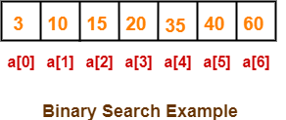
Binary Search Example-
Consider-
We are given the following sorted linear array.
Element 15 has to be searched in it using Binary Search Algorithm.

Slide 41
Step-01:
To begin with, we take beg=0 and end=6.
We compute location of the middle element as-
mid= (beg + end) / 2
= (0 + 6) / 2
= 3
Here, a[mid] = a[3] = 20 ≠ 15 and beg < end.
So, we start next iteration.
Step-02:
Since a[mid] = 20 > 15, so we take end = mid – 1 = 3 – 1 = 2 whereas beg remains unchanged.
We compute location of the middle element as-
mid= (beg + end) / 2
= (0 + 2) / 2
= 1
Here, a[mid] = a[1] = 10 ≠ 15 and beg < end.
So, we start next iteration.

Slide 42
Step-03:
Since a[mid] = 10 < 15, so we take beg = mid + 1 = 1 + 1 = 2 whereas end remains unchanged.
We compute location of the middle element as-
mid= (beg + end) / 2
= (2 + 2) / 2
= 2
Here, a[mid] = a[2] = 15 which matches to the element being searched.
So, our search terminates in success and index 2 is returned.

Slide 43
Time Complexity Analysis
In each iteration or in each recursive call, the search gets reduced to half of the array.
So for n elements in the array, there are log₂n iterations or recursive calls.

Slide 44
THANK YOU

